Slide 1




Melissa Avila – Lorenzo Howard – Sheneice Booker – Fawn Payton
4Reel
Productions

Slide 2

Table of Contents
3 - Introduction
4-6 - Importing and Analyzing the Data
7-14 - Machine Learning Models – Accuracy – Data Optimization
15 - Summary: Predictive Data for Movie Success?
16 – Thank you!

Slide 3


Introduction:
Unlocking the Box Office: Predicting Profit with Data
4Reel Productions
As we step into the spotlight, we embark on a cinematic journey fueled by data-driven insights. Our mission? To decode the enigma of box office success. From timeless classics to modern blockbusters, we’ve analyzed a treasure trove of films spanning decades. Now, armed with algorithms and creativity, we’re ready to unveil the secrets behind the silver screen. Maybe?
In doing so, it is our hopes to use this data to predict what factors impact potential profit.

Slide 4

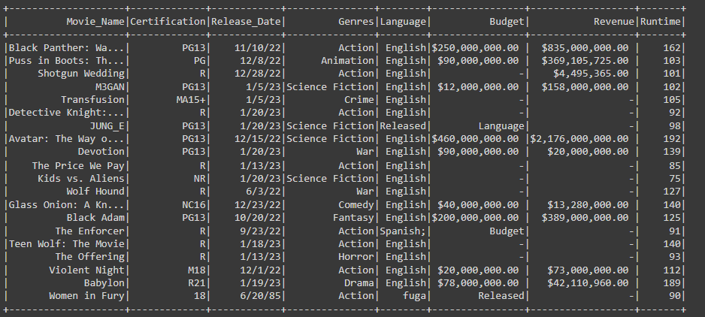
Importing and Analyzing the Data
The TMDB 3000+ Movie Dataset we chose, is a comprehensive collection of information on 3000+ of the most popular movies of all time, updated as of 2023. With this dataset, researchers, data analysts, and film enthusiasts can gain valuable insights into the movie industry and its trends over time.
We started with all of our columns: Movie Name, Certification, Released Date, Genres, Language, Budget, Revenue and Runtime(in Min).
But as we started to work with our data there were moments of frustration. We realized that if we removed some columns our data would become cleaner

Slide 5


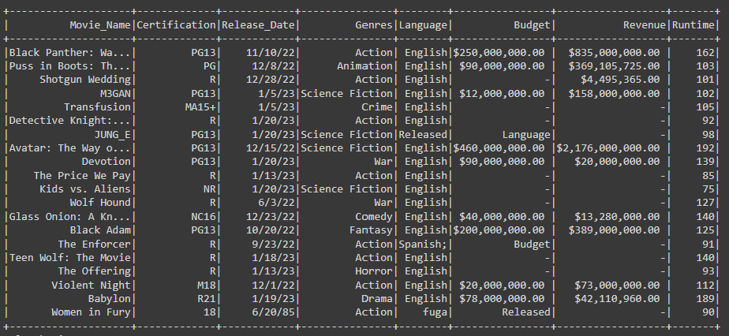
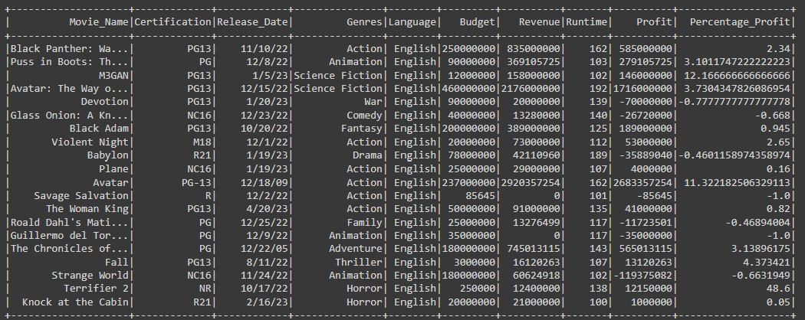
The data cleaning that was preformed:
Removed Dollar Signs and Commas
Created a New Column – Profit – which was the difference between the Revenue and Budget Columns
Removed All NULL Values to Improve Machine Learning Analysis
After
Before

Slide 6
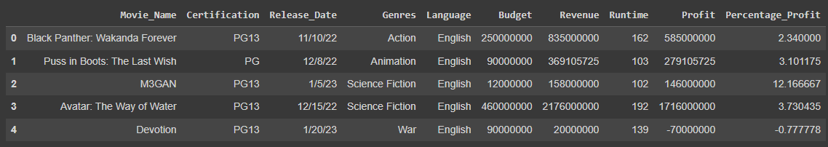
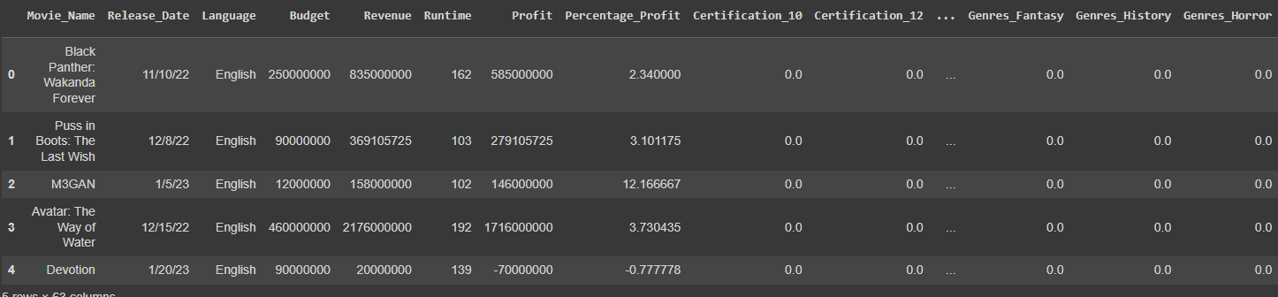
We also implemented One-Hot Encoding to transform all text in the table to zeros and ones. As well as created a new data frame to drop unnecessary columns.
Before
After

Slide 7

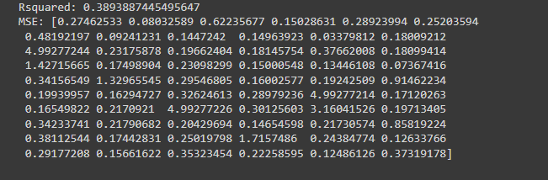
Machine Learning Models – Accuracy – Data Optimization
We coded 7 Machine Learning Models in total. We tested the accuracy, optimized and created several different data frames throughout this process.
A good R-squared value depends on the context of the study. R-squared, also known as the coefficient of determination, is a statistic that measures the strength of the relationship between a model and a dependent variable. It indicates the percentage of variance in the dependent variable that the independent variables explain together. Higher R-squared values indicate a better fit and smaller differences between the observed data and the fitted values. However, a higher R-squared value doesn't necessarily mean the model is a good predictor.

Slide 8
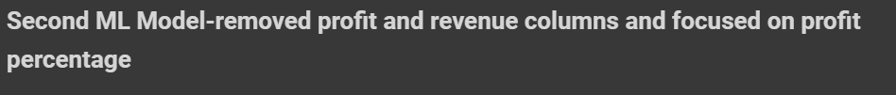
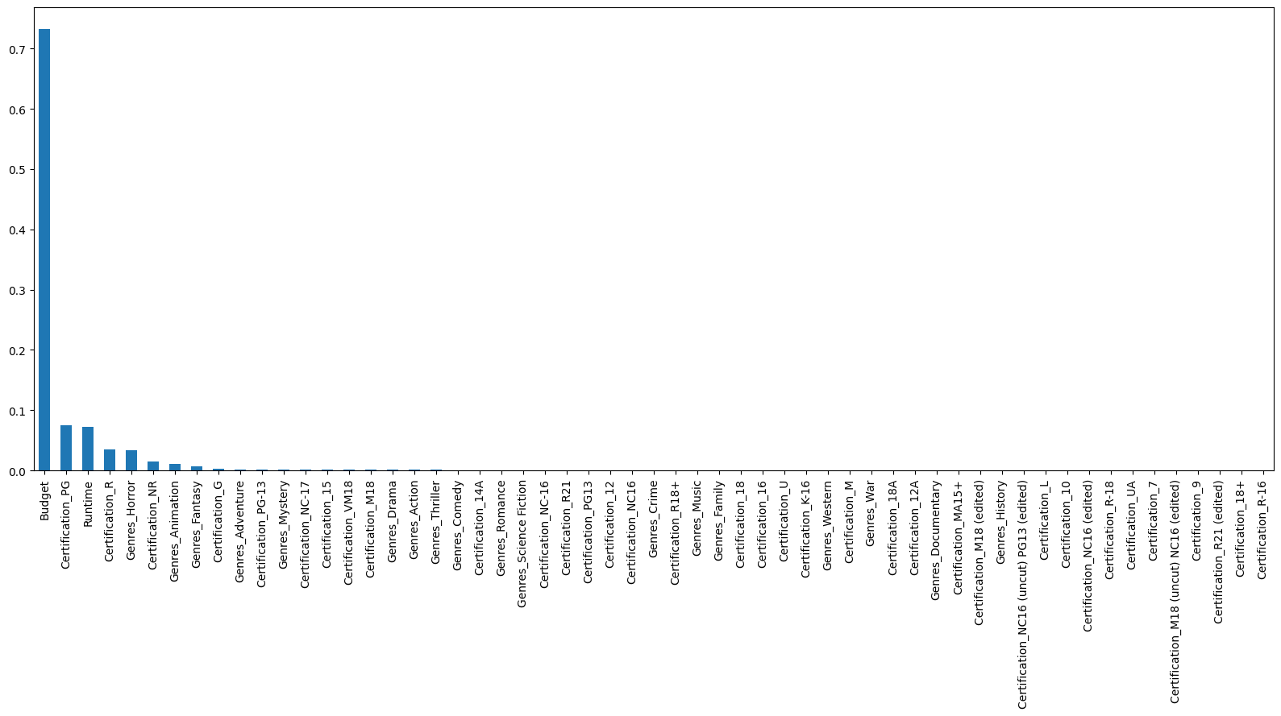

Slide 9

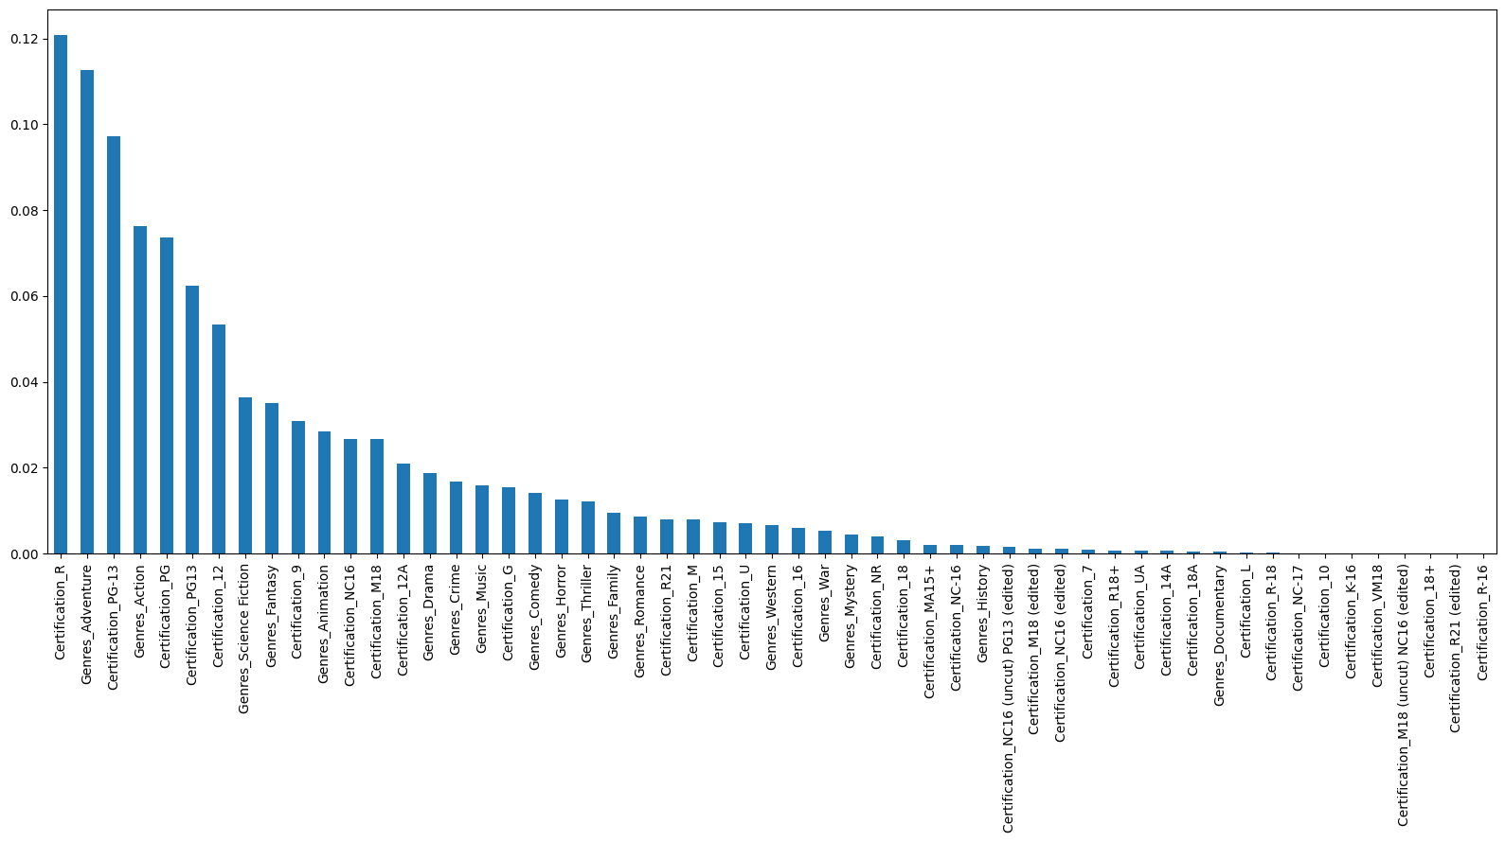

Slide 10
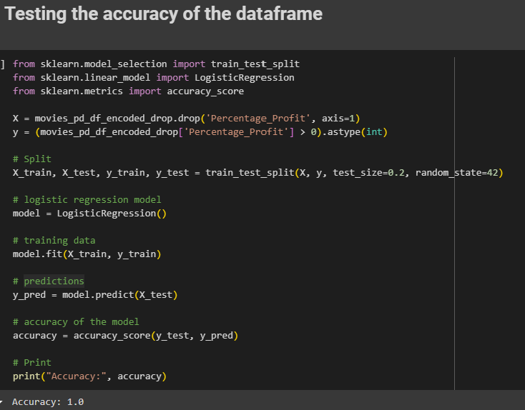
After the third ML run, we completed accuracy testing of the data frame.
Accuracy testing in machine learning is a metric that evaluates how often a machine learning model correctly predicts an outcome. It's calculated by dividing the number of correct predictions by the total number of predictions. A higher accuracy indicates better model performance, but it can be misleading in some cases. For example, if a data set is imbalanced, a model that always predicts the same class could have an accuracy of 95% even if it's not useful. In these cases, other evaluation metrics like F1 score, precision, and recall can be used.

Slide 11
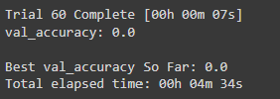
After the third ML run, we completed accuracy testing of the data frame and attempted to optimized our data.
Accuracy testing in machine learning is a metric that evaluates how often a machine learning model correctly predicts an outcome. It's calculated by dividing the number of correct predictions by the total number of predictions. A higher accuracy indicates better model performance, but it can be misleading in some cases. For example, if a data set is imbalanced, a model that always predicts the same class could have an accuracy of 95% even if it's not useful. In these cases, other evaluation metrics like F1 score, precision, and recall can be used.

Slide 12
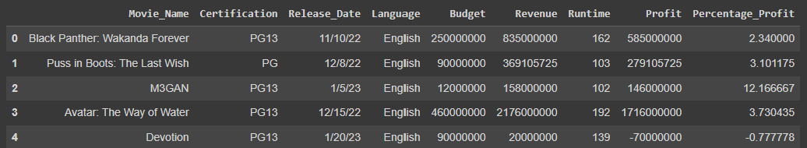
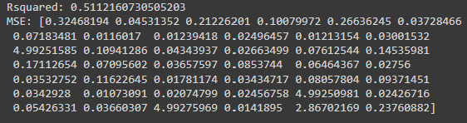
After the first accuracy run, we created a new data frame that focused on new movie certifications.
We then ran our fourth ML Model with genre removed from the data frame.

Slide 13

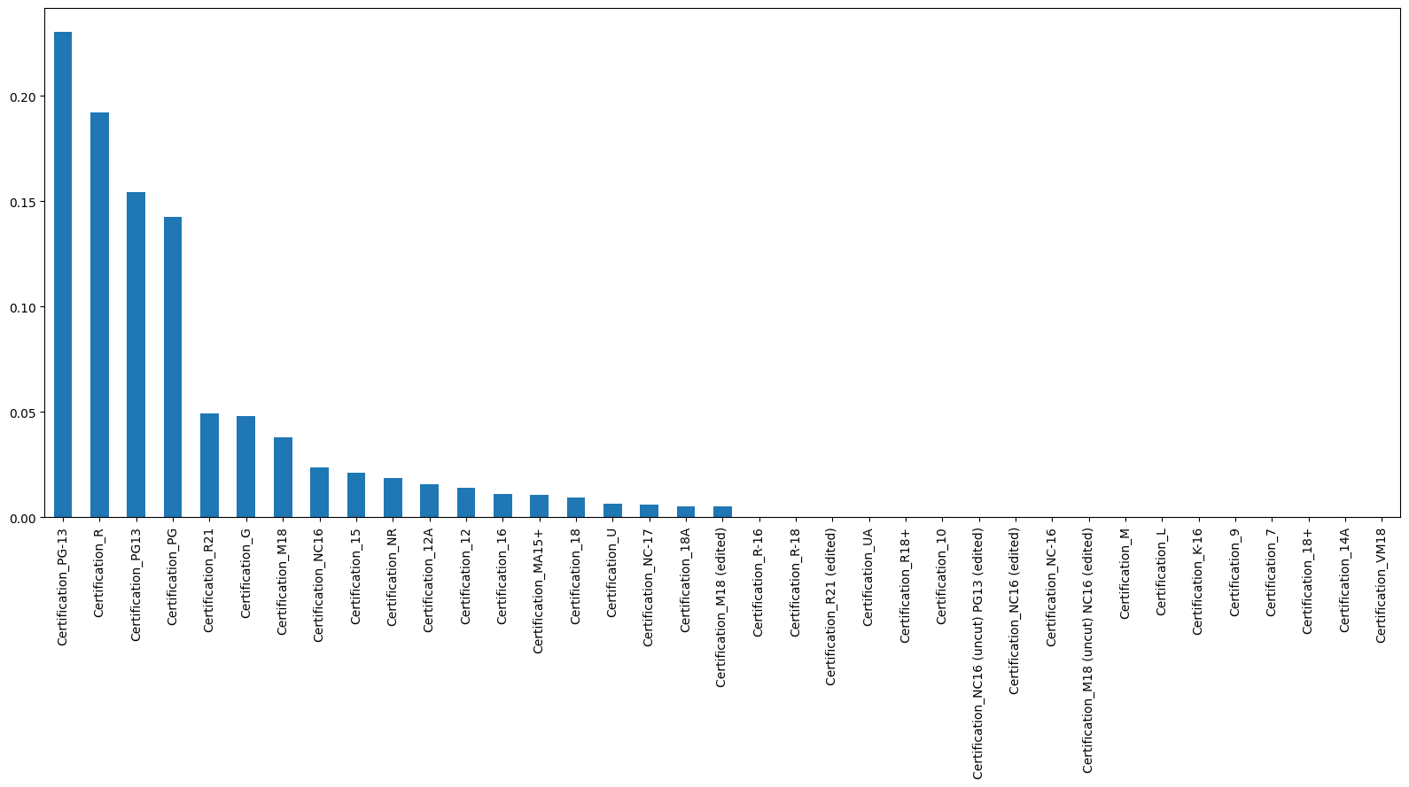

We ran another accuracy test at this point which returned at almost 100%

Slide 14
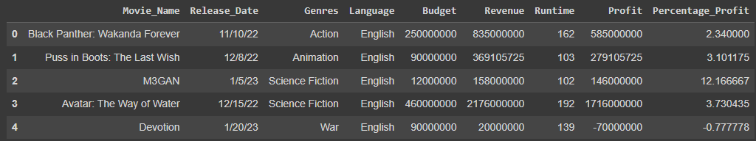



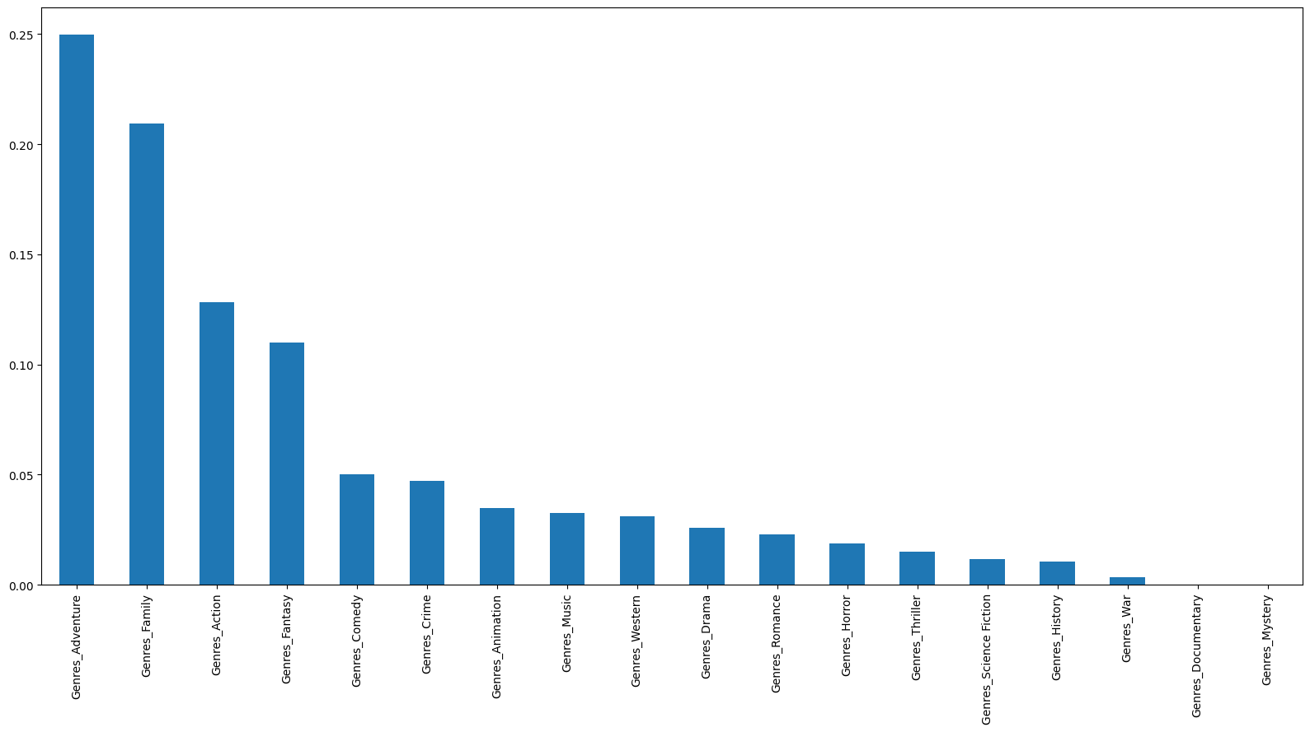
We ran another accuracy test at this point which returned at almost 100%

Slide 15

Summary: Predictive Data for Movie Success?
The TMDB 3000+ Movie Dataset, while comprehensive, is not free from inaccuracies and inconsistencies. But did give us an interesting insight. By removing some data points our data became cleaner.
Genres: Certain genres consistently perform well. Action, adventure, fantasy, and sci-fi films tend to attract large audiences. Filmmakers often leverage these genres to maximize box office revenue.
Runtime: While there’s no magic runtime, striking a balance is crucial. Too short, and audiences might feel unsatisfied; too long, and attention wanes. Aim for engaging storytelling within a reasonable duration.
Production Costs: High budgets don’t always guarantee success. Efficiently allocating resources and managing costs is essential.
If our data contained additional details such as race or revenue by state/city, the process may have been less frustrating. But it could also be said that this particular dataset topice may not be capable of providing true predictive data compared to a topic such as real estate.

Slide 16

Thank you!

